Slide 1

Real Time Sleeping detection using computer vision
Under Supervision of: Dr. A. Halder
Presented by: Dhiren And Gopinath.
Dept. of Computer Applications
Presentation I

Slide 2
Contents
Introduction.
Objective and Importance.
Proposed Tools / Environments .
Proposed Methodology / Literature Review.
Flow Chart.
Progress Report.
References.

Slide 3
Introduction
Driver inattention is one of the main cause of traffic accidents, Monitoring a driver to detect inattention is a complex problem that involves physiological and behavioral elements. Different approaches have been made, and among them computer vision has the potential of monitoring the person behind the wheel without interfering with his driving.
A System that can monitor the alertness of drivers in order to prevent people from falling asleep at the wheel. The other main aim of this algorithm is to have efficient performance on low quality webcam and without the use of infrared light which is harmful for the human eye.
Motor vehicle accidents cause injury and death, and this system will help to decrease the amount of crashes due to fatigued drivers.
The proposed algorithm will work in three main stages:
In the first stage, the face of the driver is detected and tracked.
In the second stage, facial features are extracted for further processing.
In the last stage, the most crucial parameter which is eye’s status.

Slide 4
objectives
To detect the drowsiness of the driver behind the wheel without interfering his driving and alert him to take a break.
The algorithm should be efficient and robust enough to detect drivers drowsiness in real time.
To detect the face and tracing it.
To detect the status of the eyes.
To record the real time video while driving for future references.

Slide 5
Tools / Environments Used
Environment:
Windows 10,7
Tools:
Matlab R2012a
Camera: Dell webcam YUY2 720x480
Hardware:
Ram:4GB
Core i3 2.20GHz

Slide 6
Methodology
DVP: A video refers to a sequence of time varying still images that carries some visual
information. In other words, a video is defined as a continuous arrangement of image
frames showing movement of objects. DVP is a task of processing a digital video in order to obtain some useful information from it.
Various Step of DVP:
Video Acquisition.
Pre-processing.
Compression.
Segmentation.
Representation.
Classification and Description.

Slide 7
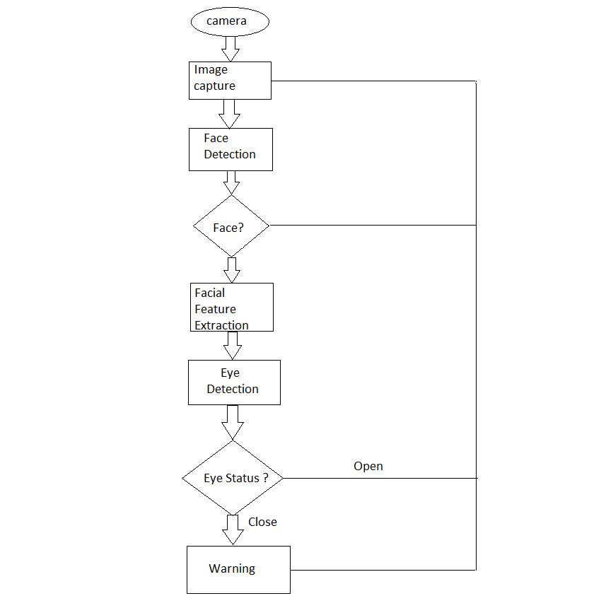
Flow Chart

Slide 8




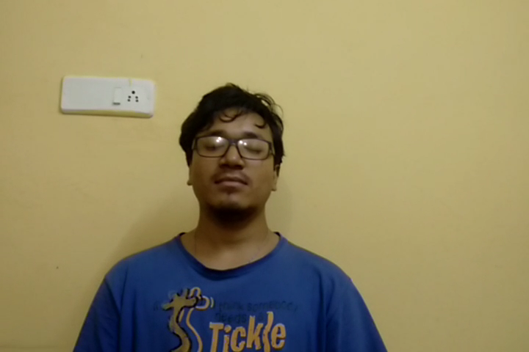



Dataset and frames
Frame1
Frame37
Frame1520
Frame1794
Frame1680
Frame420
Frame1
Frame2301

Slide 9
Progress report
Done:
Video Acquisition.
Frames Extraction.
Reading the Number of objects.
Recognize the Respective pixel values.
Current:
Working on frame differencing pixel by pixel.
Object Segmentation.

Slide 10
References
On Detection and Tracking of Moving Objects In video Scenes, By: B. N. Subudhi.
Real Time Detecting Driver’s Drowsiness Using computer vision, By: kusuma kumara B.M.

